Slide 1
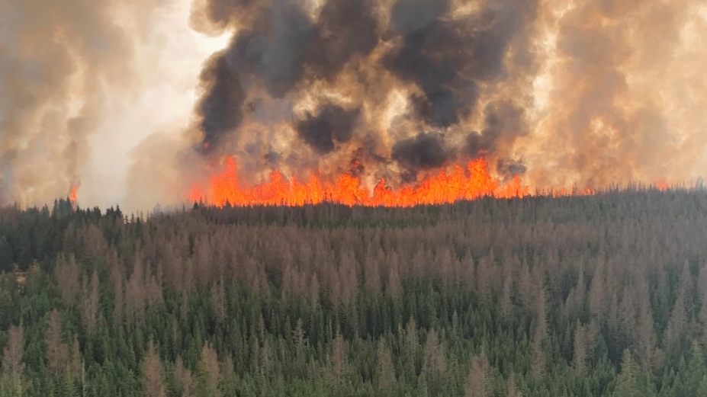


Forecasting Natural Gas Production in Alberta Through Wildfire Analysis
Yong Lee, Jacob Winch For Energy Hackathon 2024

Slide 2
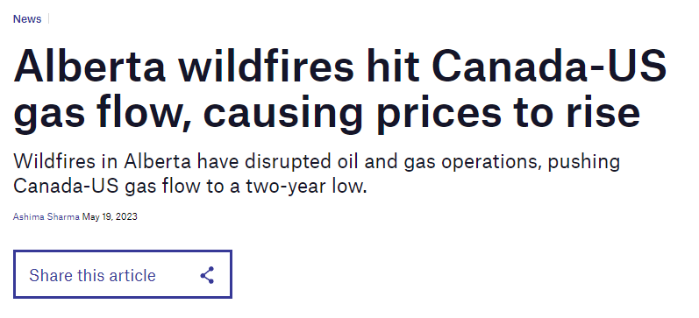
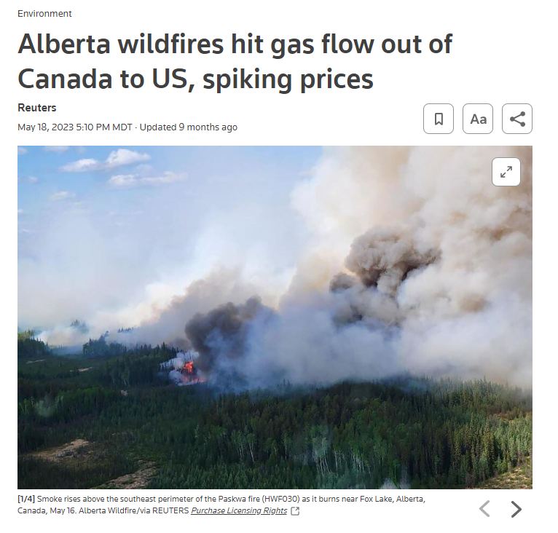
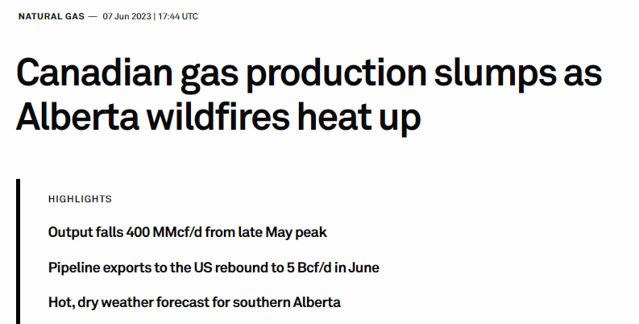
Motivation
Natural Gas Generates 72.6% of Electricity in Alberta (2022)*
*Annual Electricity Data by AUC - https://www.auc.ab.ca/annual-electricity-data/

Slide 3
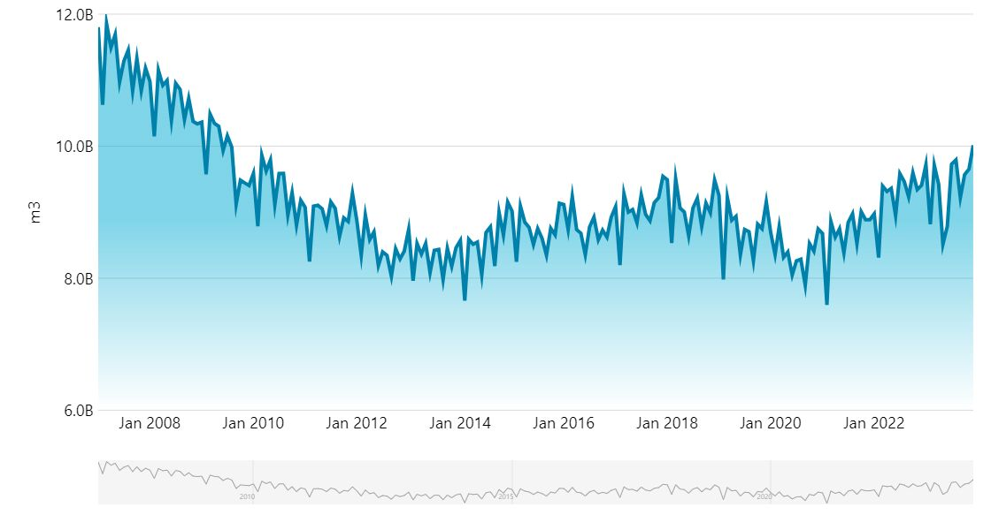
Alberta Natural Gas Production
In May 2023, marketable natural gas production was 8.5B cubic metres, down 9.66% from April 2023*. During May 2023, Alberta's wildfires were the worst the province has ever seen in the spring, with a record breaking 1,017,00 hectares burnt from the start of the fire season to May 23rd, 2023**.
*Natural Gas Production. Alberta Economic Dashboard. https://economicdashboard.alberta.ca/dashboard/natural-gas-production/
**2023 wildfires in Alberta worst record for Spring. CityNews Edmonton. https://edmonton.citynews.ca/2023/05/23/worst-spring-wildfire-season/#:~:text=Last%20Updated%20May%2023%2C%202023,fires%20have%20burnt%201%2C017%2C000%20hectares.

Slide 4
Data Ingestion, Cleaning, Compiling
Wildfire data: 2006.Apr to 2021.Dec
https://www.alberta.ca/wildfire-maps-and-data
Natural Gas Historical Production in Alberta: 2007.Jan to 2023.Dec
https://economicdashboard.alberta.ca/dashboard/natural-gas-production
ST50: Gas Processing Plants in Alberta
https://www.aer.ca/providing-information/data-and-reports/statistical-reports/st50
Nova Gas Transmission Ltd. (NGTL) Pipeline
https://open.canada.ca/data/en/dataset/dc343c43-a592-4a27-8ee7-c77df56afb34

Slide 5
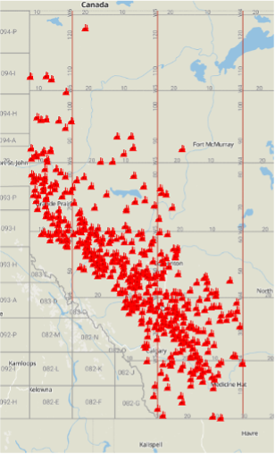
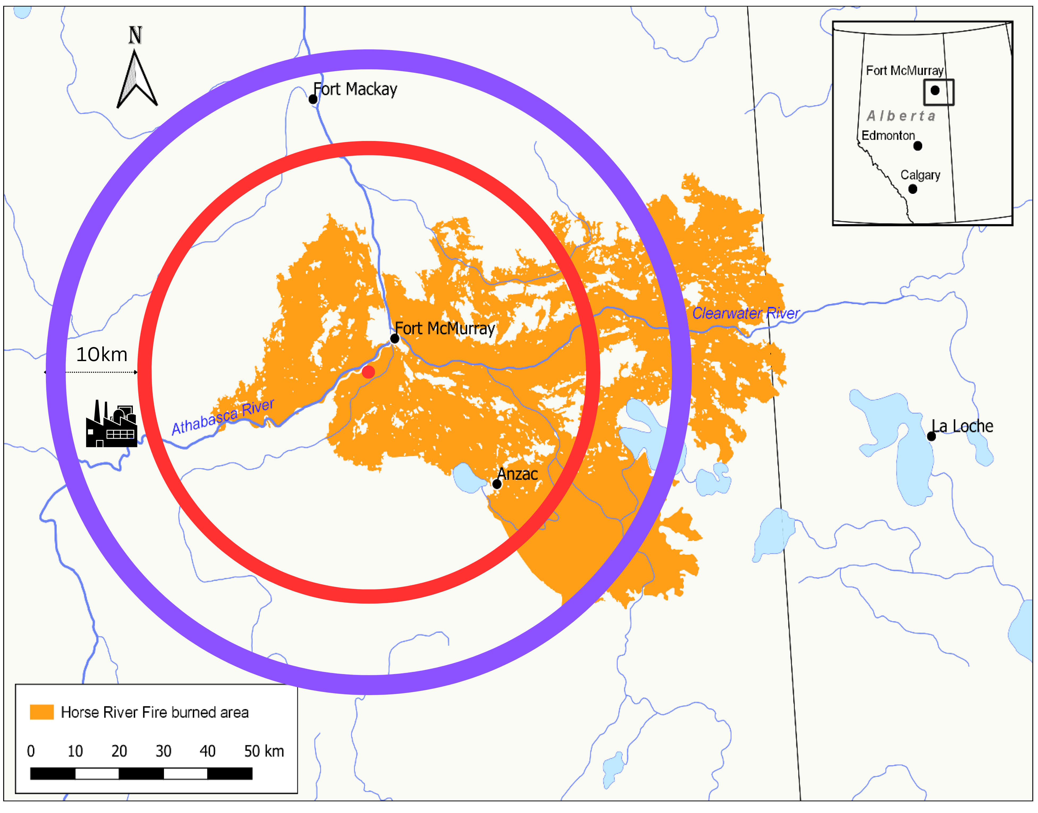
Feature Engineering
Gas Plant Locations in Alberta
BOE Reports. https://boereport.com/2023/04/26/xi-technologies-alberta-gas-processing-a-summary/
Incentives and Barriers to Homeowners' Uptake of Firesmart. https://www.mdpi.com/2571-6255/5/3/80
Example: 2016 Horse River Wildfire

Slide 6
Fire Impact on Facilities & Infrastructures
Haversine Formula Use:
Calculated "as-the-crow-flies" distance between two points, factoring in Earth's curvature, using coordinates in radians.
Distance in Meters:
Applied Earth's radius (~6371 km) within the Haversine formula to output distance in meters.
Fire Impact Assessment:
Assessed if facilities are within a fire's impact zone by comparing the calculated distance to the fire's radius, assumed as a circle for simplicity.
Adds safety margins: 10 km for gas plants and 5 km for pipelines, based on industry safety standards, to account for indirect fire impacts.

Slide 7
Model Features
Fire Size Class: ['A', 'B', 'C'. 'D', 'E']. A class = 0 to 0.1 ha B class > 0.1 ha to 4.0 ha C class > 4.0 ha to 40.0 ha D class > 40.0 ha to 200 ha E class > 200 ha
Year: Fire year
Month: Fire Month
Gas Plant Frac (1000 m3/d): Gas Plant Fractionation: The process of boiling off the different hydrocarbons.
Gas Plant Sweet (1000 m3/d): The Process of removing hydrogen sulfides.
Gas Plant Flaring (1000 m3/d): Burning of natural gas
Gas Plant Acid Gas Flaring %
Gas Plant Acid Gas Inj (1000 m3/d): Gas Plant Acid Gas Injection
Gas Plant Mainline Strdle (1000 m3/d): Gas Plant Mainline Straddle. Recover NGL components
Gas Plant Sulphur Recovery (1000 m3/d)
Pipeline Average Capacity (1000 m3/d):

Slide 8
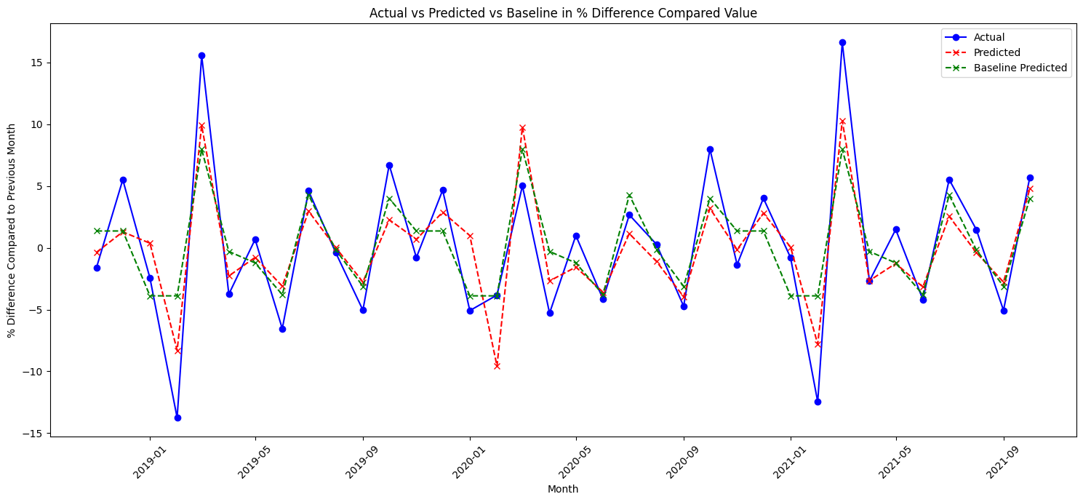
Results
Random Forest Regressor(Best Performing) MSE: 10.1542, R-squared: 0.7417
Baseline (Seasonal Pattern) MSE: 13.6521, R-squared: 0.6527

Slide 9
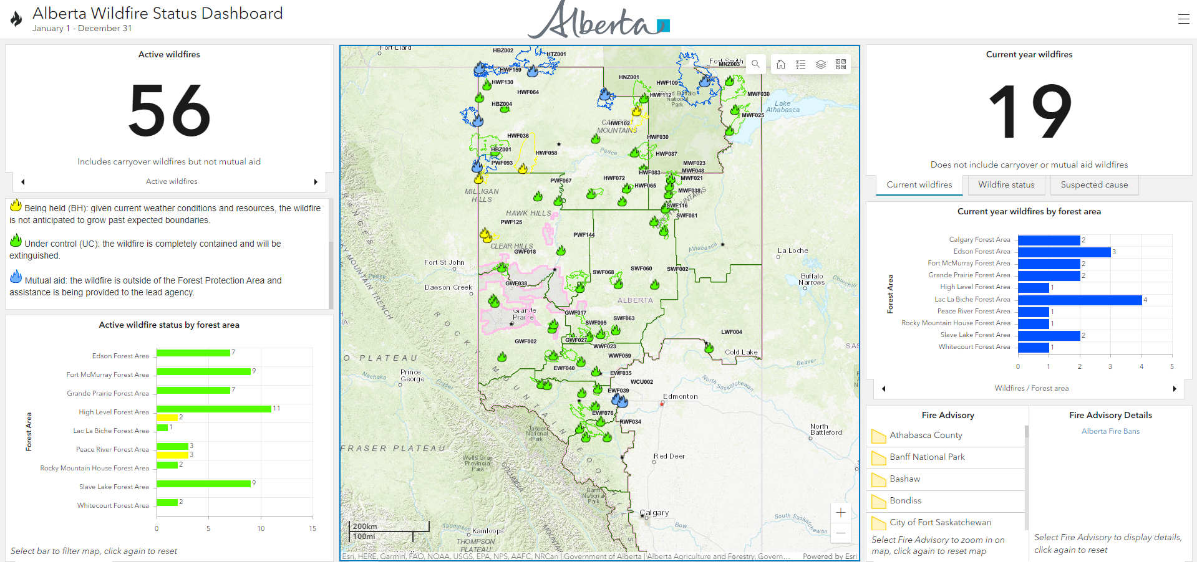
Alberta Wildfire Status Dashboard on ArcGIS
https://www.arcgis.com/apps/dashboards/3ffcc2d0ef3e4e0999b0cf8b636defa3

Slide 10

Real-time Wildfire Data available on CIFFC
The Canadian Interagency Forest Fire Centre (CIFFC) is a not-for-profit corporation owned and operated by the federal, provincial and territorial wildland fire management agencies
https://geoserver.ciffc.net/en/national-fires?filter_agency_code=All&stage_of_control=All&response_type=All&page=1&order=wildfire_agency_fire_id&sort=desc
Our model predicts a 9.49% decrease in Natural Gas Production for February 2024 in Alberta.

Slide 11
Difficulties Faced & Limitations
Isolating individual wells impacted by wildfires
Attributing Causality
In addition to gas processing plants and pipelines we also tried to incorporate individual gas wells. However, we struggled with isolating the location of each well.
Due to a multitude of factors influencing natural gas production it is difficult to determine if an increase in wildfires in Alberta truly causes fluctuation in natural gas production. However, we can confidently say that at least some of the change is due to wildfires.
Map-90: Designated Oil and Gas Fields, and Oil Sands Deposits. https://www1.aer.ca/productcatalogue/187.html

Slide 12
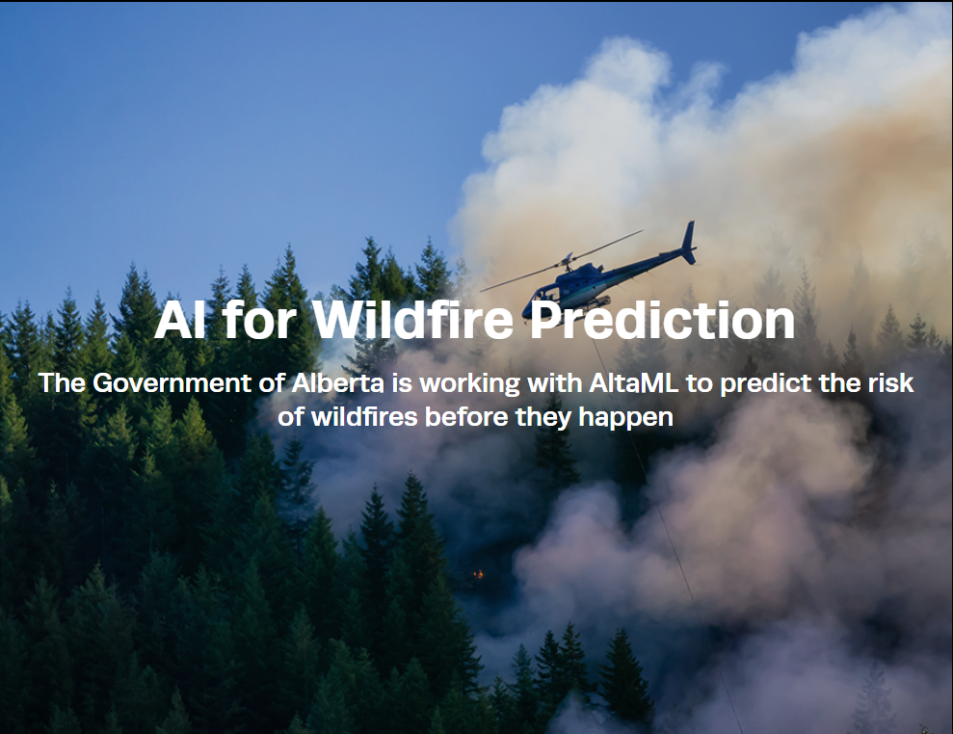
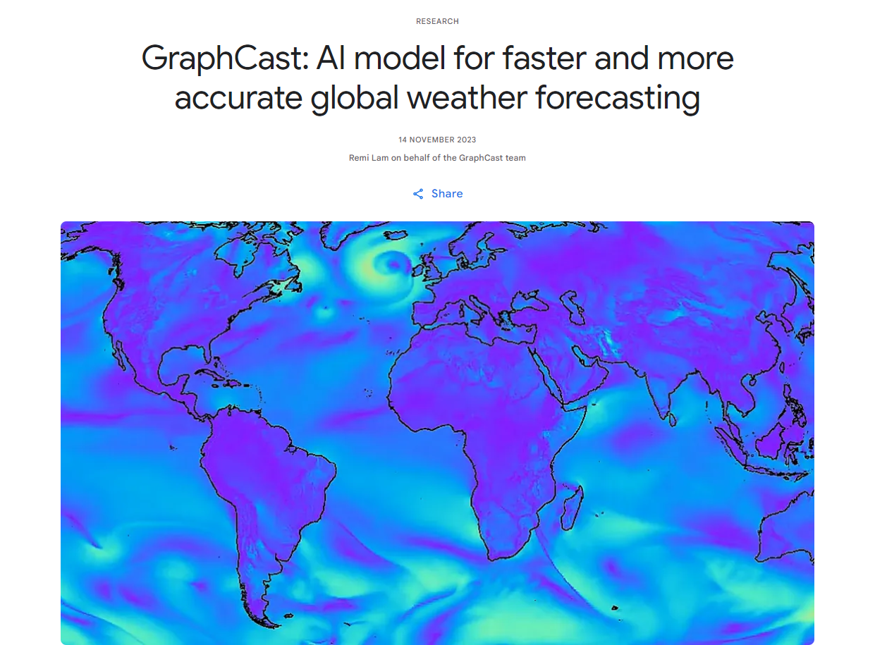

What's Next?
Incorporating state of the art wildfire prediction models to forecast impacts to Alberta's natural gas production.
AI for Wildfire Prediction. AltaML. https://www.govlab.ai/wildfire-prediction
Google Deepmind. https://deepmind.google/discover/blog/graphcast-ai-model-for-faster-and-more-accurate-global-weather-forecasting/

